Slide 1
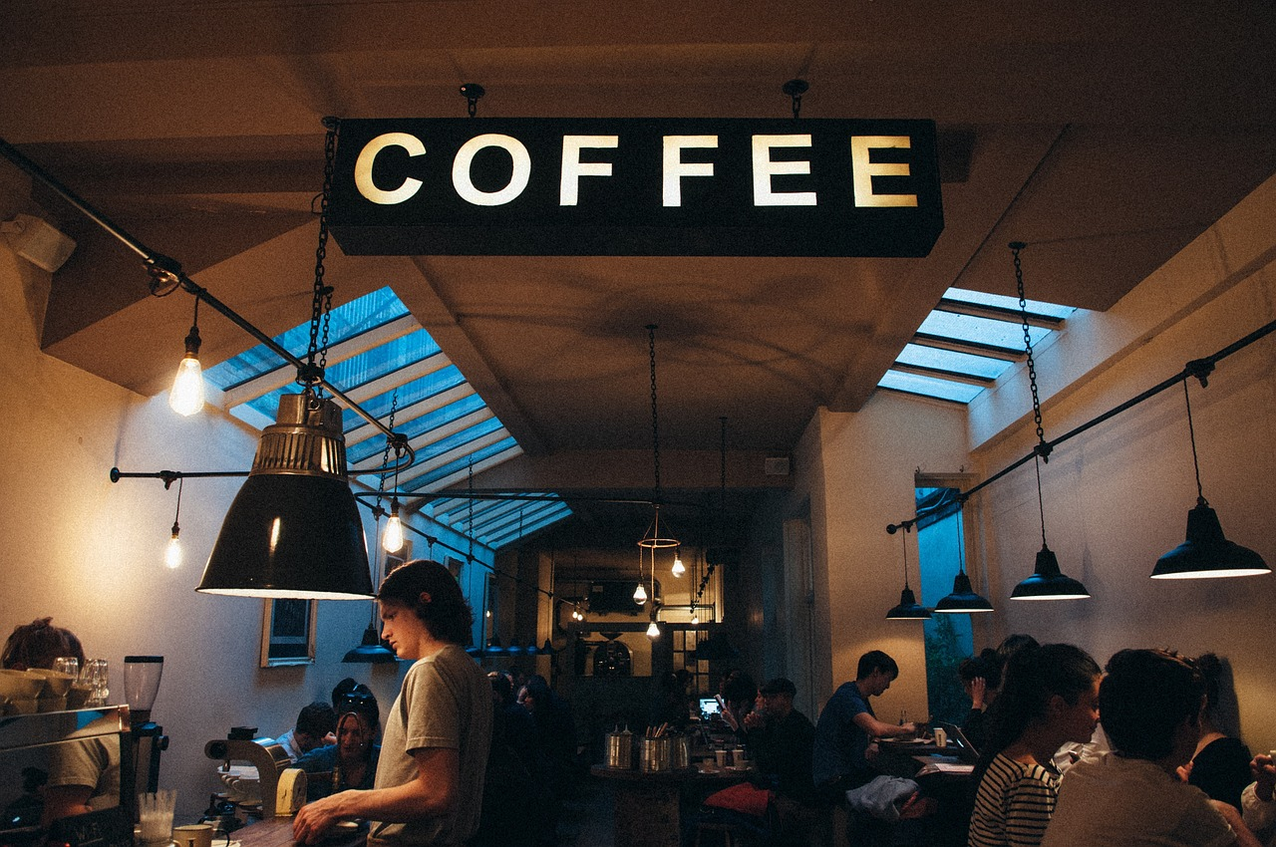
WHO LOVES…
?
Notes:
Banke will do intro

Slide 2
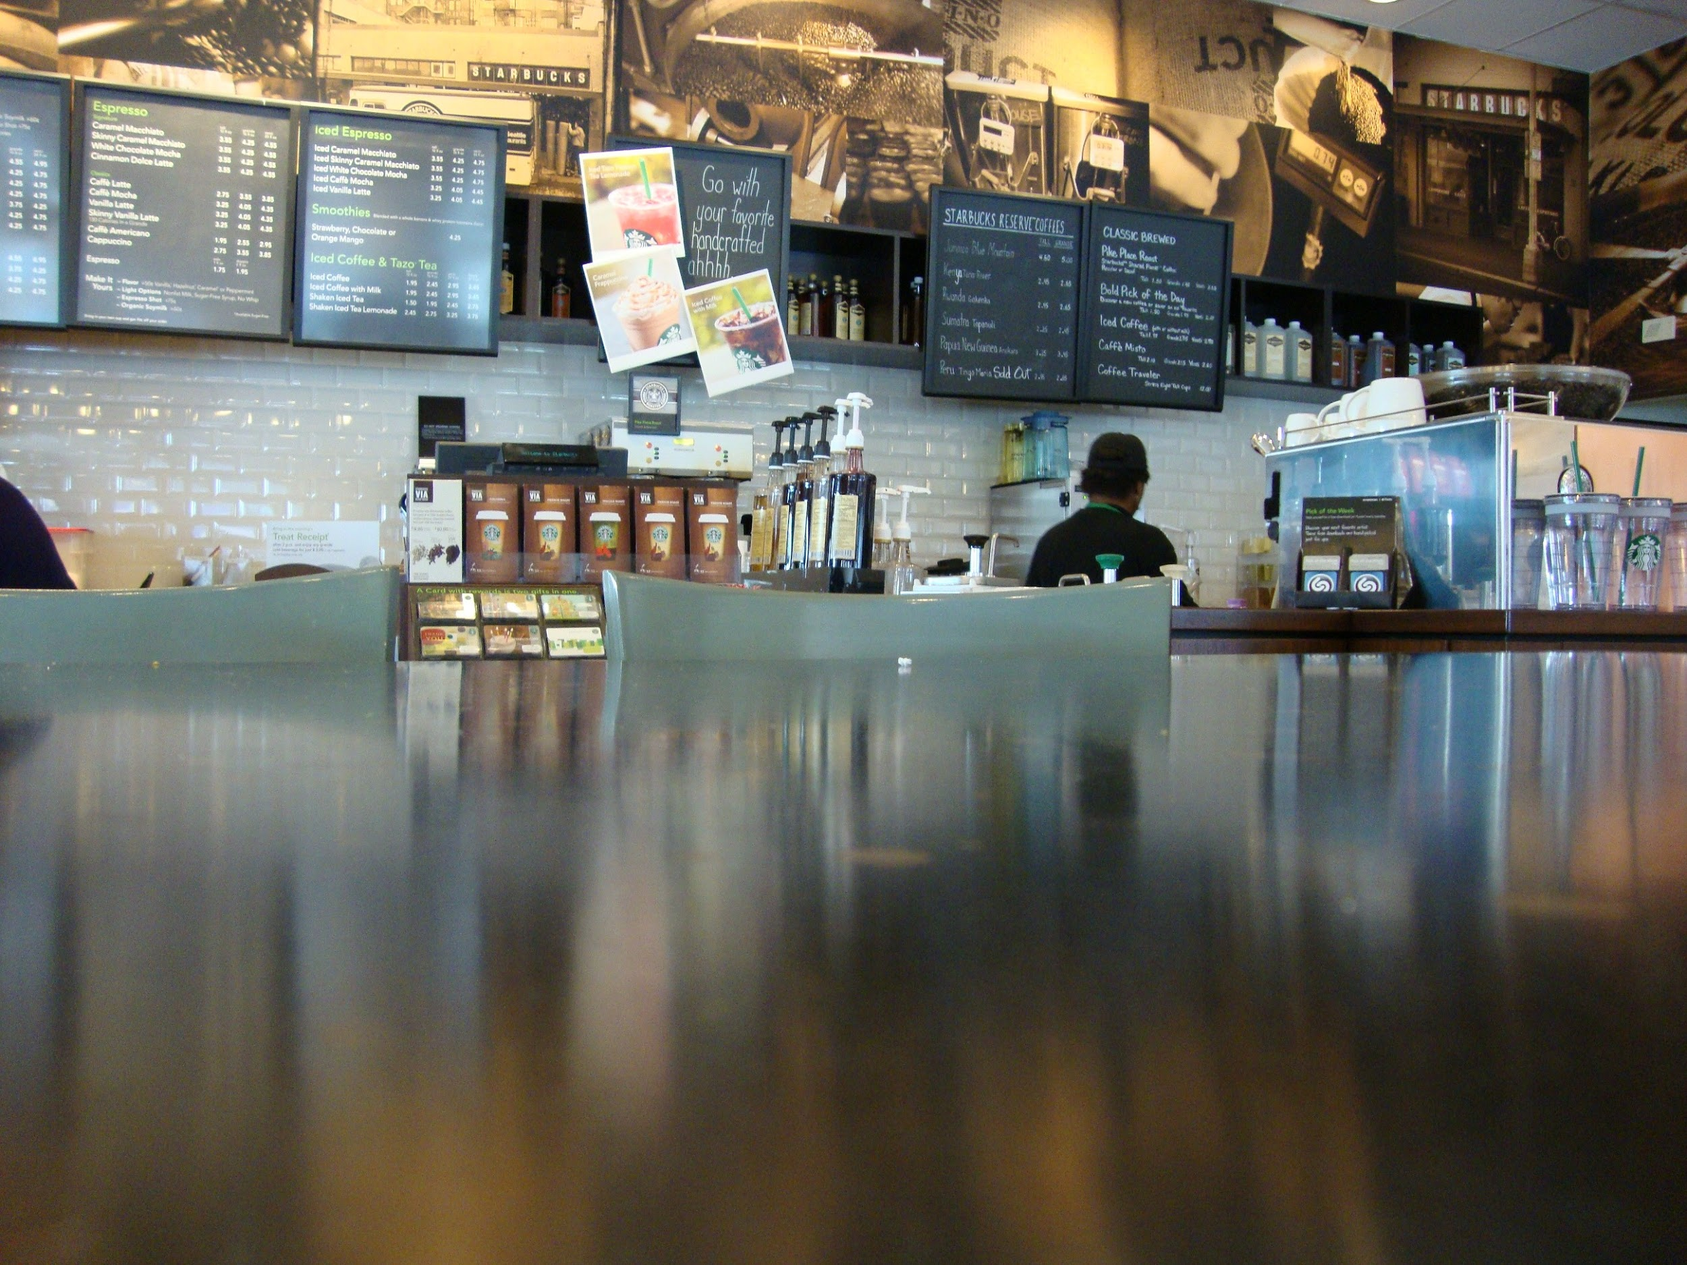
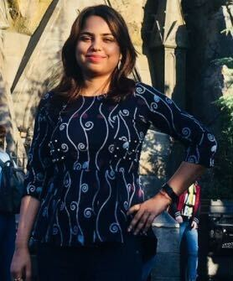
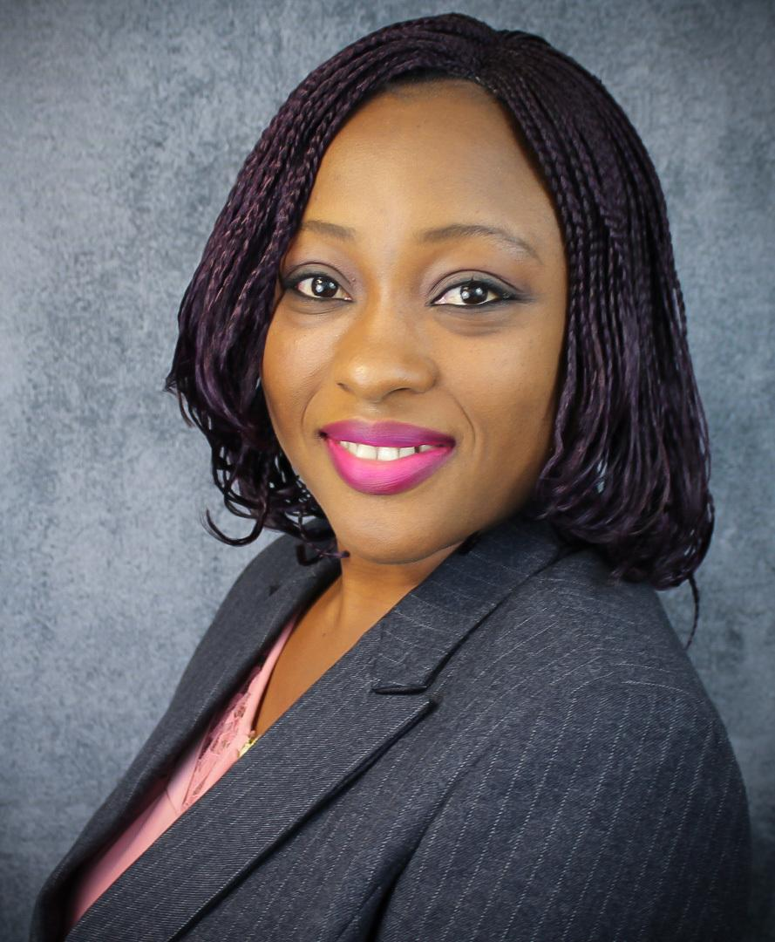
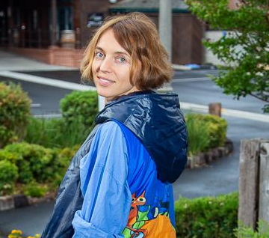

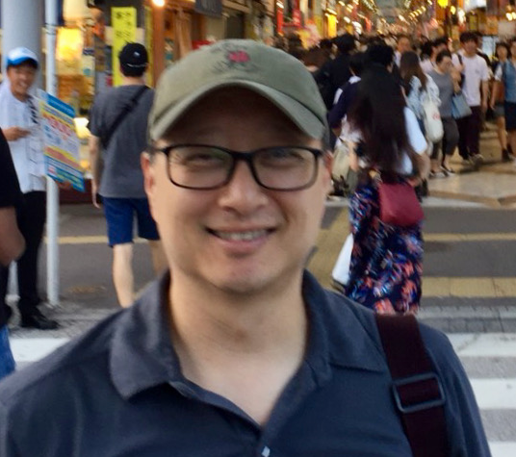
Our Over Caffeinated Team:
“No Coffee - Chai”
Priya Singh
“Mucha Mocha”
Banke Ogunjumo
“A Hot Cup of Weiner Melange is All I Need ”
Galyna Malynska
“Mo’ Macchiato”
Michael Liu
“Better Latte Than Never”,
Jasper Chou
Notes:
Banke will explain

Slide 3
What is our project about...
How popular is coffee as a beverage in the US
Is the retail coffee business a viable endeavor?
To show how engaging the American coffee drinker is.
Notes:
Jasper will explain

Slide 4

The Supplier of Our Data
Notes:
Jasper will explain

Slide 5
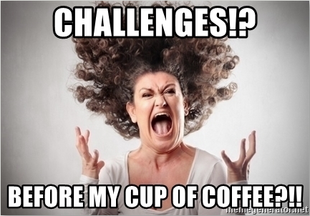
Dataset too large to use locally
Data contained cryptic information
Duplicate data was frequent
Incomplete Datasets
Our Solution: AWS Athena!!
Notes:
Jasper will explain and turn over to Galyna

Slide 6

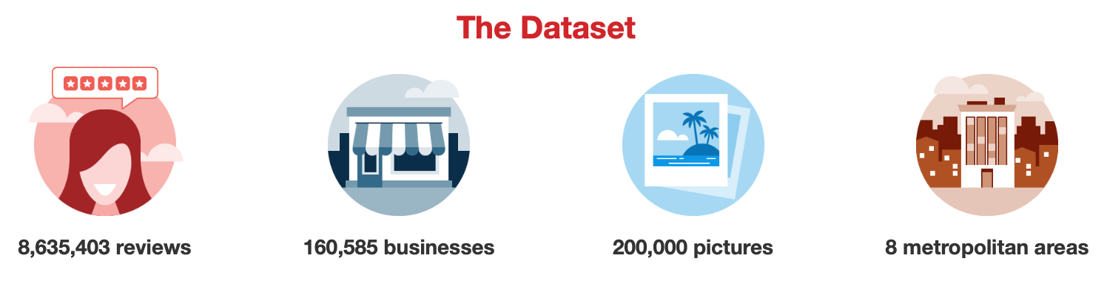



Yelp Data Set
review.json ~ 7GB
user.json ~ 4GB
S3
Athena
Notes:
Galyna will explain

Slide 7
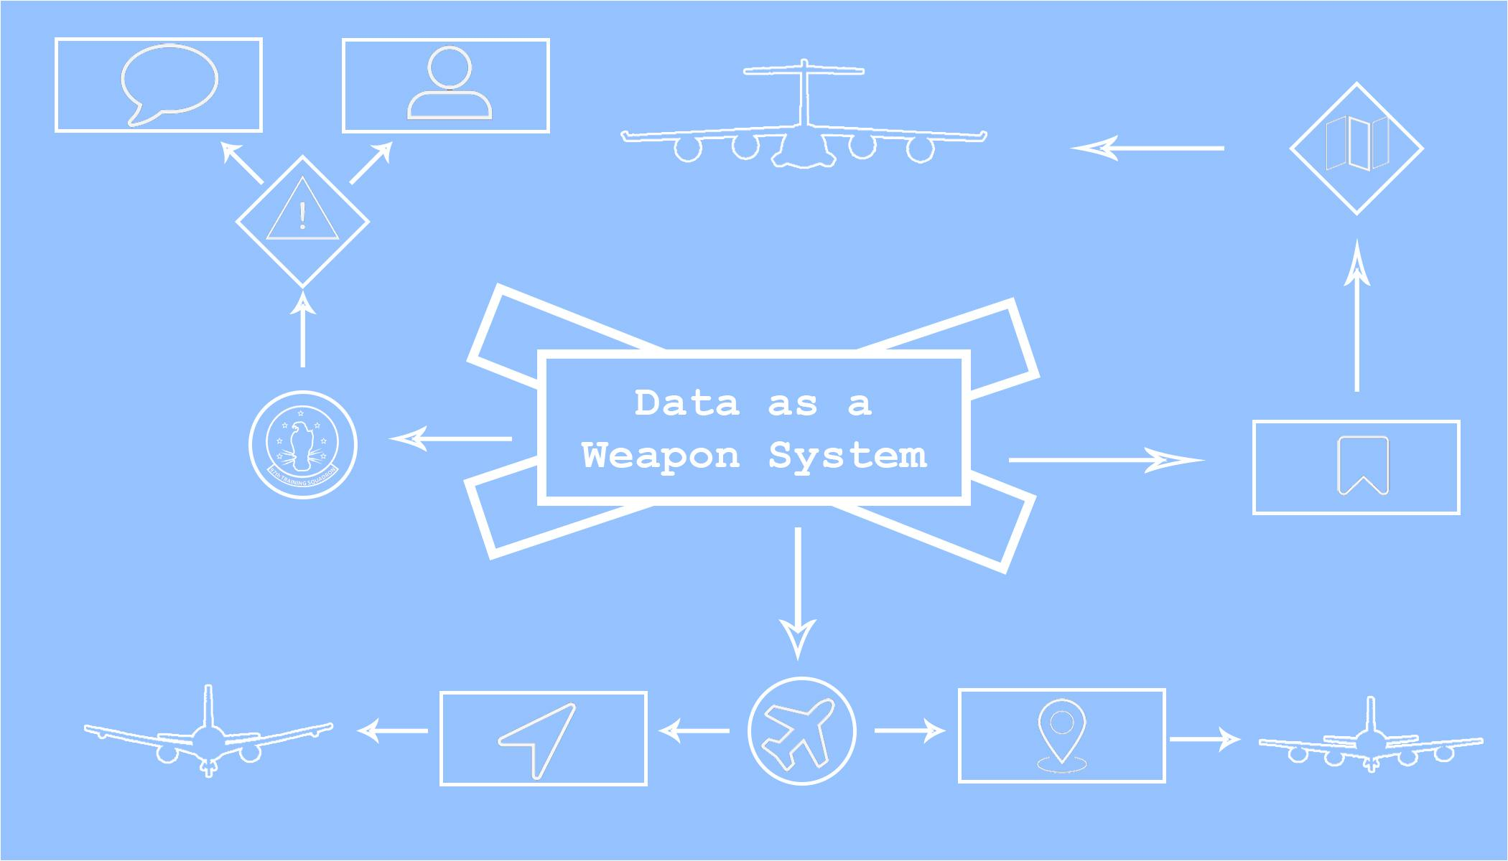
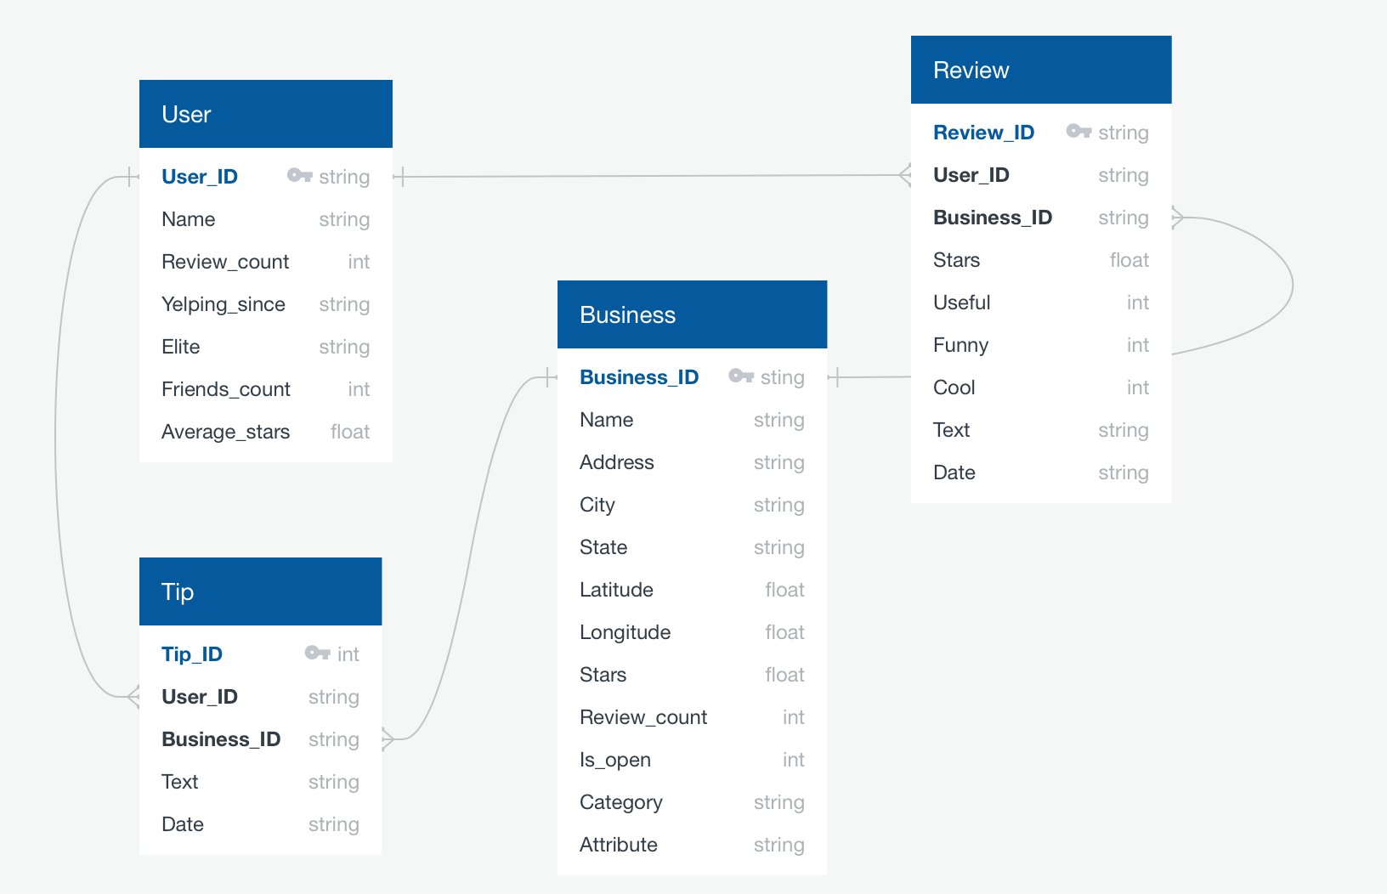
DataBase Schema
Data as a Weapon System
Notes:
Galyna will explain

Slide 8

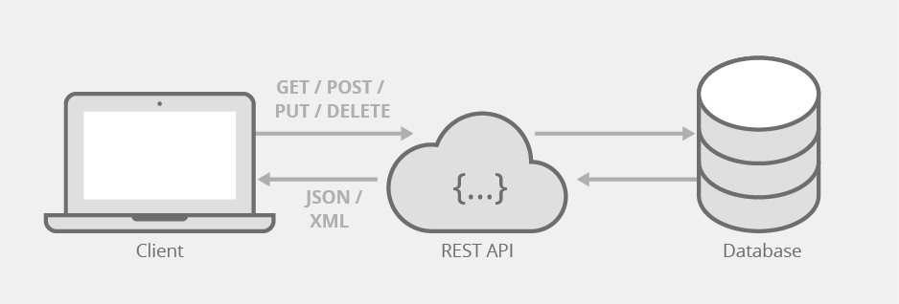





REST API in Python using Flask
Notes:
Galyna will explain

Slide 9
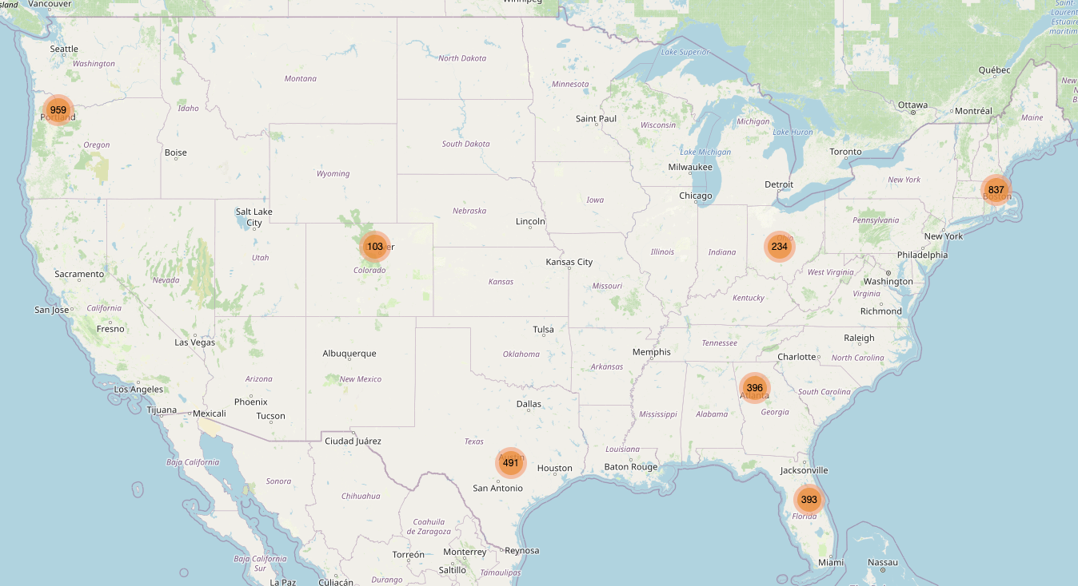
I Spilled Coffee on
My Dashboard!!
Notes:
Galyna will open the dashboard and explain her part

Slide 10

Where is my cup of coffee?
Notes:
Jasper will explain

Slide 11
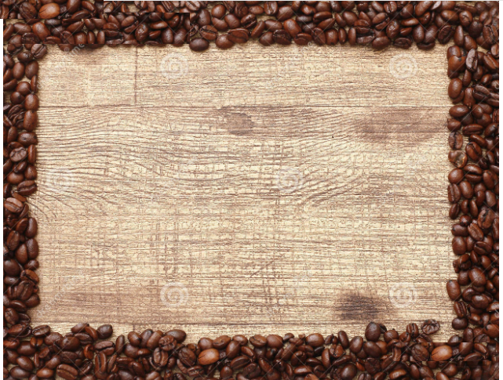

Reviews & Ratings
‘Mike's Pastry is one of the "must visit" spot in if visit Boston’
‘I've never seen so many positive reviews about a singular place on Yelp as Mike's Pastry’
‘Would I line up at midnight for 30 minutes trying to buy one? Probably not but then again, it's all personal pref’
‘I expected so much given the line was out of door but i have to say i was let down’
Notes:
Galyna will had over to Priya to discuss her part of the dashboard

Slide 12
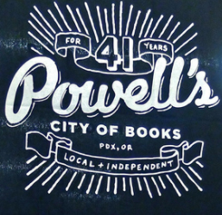
Reviews & Ratings
‘Nice coffee shop inside Powell's Books’
‘Books and coffee go hand in hand, so Powell's book have a great little coffee shop in their store. You can sit in or walk around Powell's which is genius because it keeps you book shopping longer. Great idea! ‘
‘Great place to get lost! Meet me in the Red Room and we can get a cup of coffee’
‘Grab a handful of potential purchases & go to the Coffee shop’
Notes:
Priya will explain

Slide 13

Reviews & Ratings
‘Elizabeth Street Cafe is so pretty! The ambiance is so cozy and beautiful. A nice and simple set up’
‘The Vietnamese coffee was a disappointment. They used Cafe du Monde brand and were pretty chintzy on the sweetened condensed milk’
‘Delicious Vietnamese coffee!!’
‘Long wait but so worth it. They serve Stumptown coffee’
‘There were quite a few flies inside flying around our table’
Notes:
Priya will explain

Slide 14

Top Cities With Coffee Business
Notes:
Priya explain and then hand it over to Michael

Slide 15
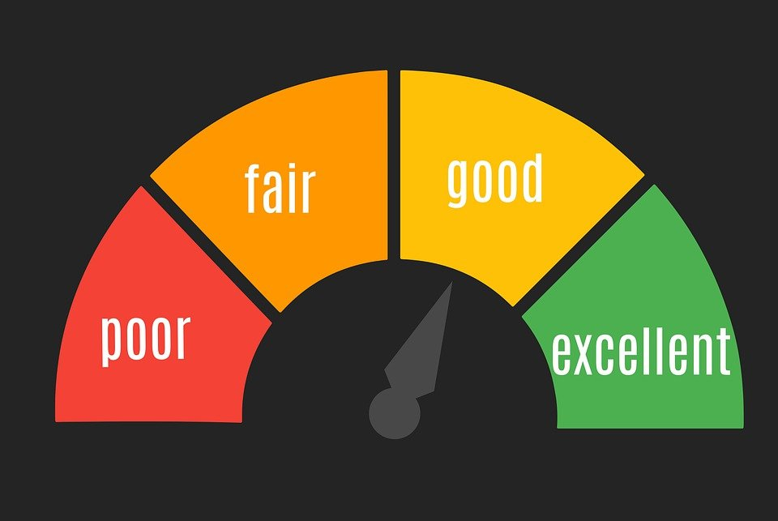
Rating by States?
Notes:
Michael will explain

Slide 16

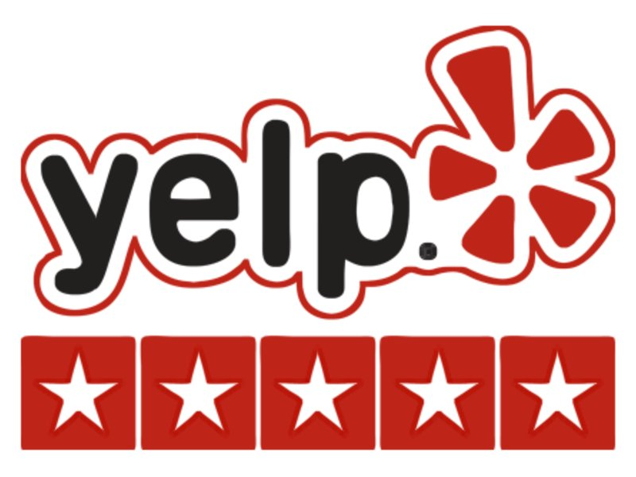

Twinkle Twinkle Little Star
Winners of best star rating~
State of Oregon!!!
341 five Stars
Winners of Highest Reviews~
State of Massachusetts!!!
4216 Reviews
Notes:
Michael will explain

Slide 17
Conclusion: Drink more coffee!
In each of the metropolitan areas surveyed, there were at least 300 coffee shops to serve a population between 150k and 1mm people. The retail coffee business is doing well (except during the COVID pandemic of 2020), based on its popularity and overall engagement on Yelp.com. Overall the retail coffee business is steadily growing over the years, making it a viable enterprise for the future.
Notes:
Banke will explain and conclude

Slide 18
Questions?
Notes:
Jasper will explain

